Slide 1

Machine Learning Hackathon CG 2022
Team Name- Dogs&Cats
Team Leader Name- Shreyas Vedpathak
Team Leader Email Address- shreyasvedpathak@gmail.com

Slide 2
Brief description of the problem at hand:
Phishing is a sort of social engineering attack that is frequently used to acquire user information such as login passwords and credit card details. It happens when an attacker poses as a trustworthy entity and tricks the victim into opening an email, website, instant message, or text message.
The receiver is subsequently duped into clicking a malicious link, which can result in malware installation, system freeze as part of a ransomware assault, or the disclosure of sensitive information.
An attack can have disastrous consequences. Individuals are affected by illicit purchases, loss of cash, or identity theft.
Problem Statement:
To identify whether the website is legitimate or phishy.

Slide 3
Solution proposed and description:
Reading Data
Exploratory Data Analysis
Feature Engineering and Feature Selection
Model Training
Model Evaluation
Model Deployment (if applicable)

Slide 4
Solution proposed and description:
INPUT LAYERS:
A layer that reads all the features individually along with their data type.
INTERMEDIATE LAYERS:
A layers that takes input from each input layer and Normalizes by using Normalization layer.
A single fully connected dense layer having 64 neurons with leaky relu activation function.
OUTPUT LAYER:
A single dense layer with 1 neuron, sigmoid as activation function.
(As no feature were categorical, encoding features was not required.)

Slide 5
Technology/Tool Stack Used:
Language:
Python
Frameworks:
Scikit-learn
Pandas
NumPy
Tensorflow
Keras
Hardware/Software used for implementation:
Google Colab
Jupyter Notebook
Tableau

Slide 6
Approach:
Separate Features and Label columns.
Replace -1 in labels column with 0 (so labels are now 0-phishy, 1-legitimate)
Drop ‘key’ column as it is unnecessary
Check for missing values
Study correlation matrix
Split and Create TensorFlow dataset using csv, followed by batching
Define model (normalization included in model only)
Train model
Analyse Tensorboard for overfitting/underfitting
Retrain (if required given above conditions)
Draw inference on test set (for submission)
Replace 0 with -1 to keep labels consistent with dataset given.
Create a csv of submission with key and Result as columns.

Slide 7
Approach: Model Training Details
OPIMIZER: Adam
LOSS FUNCTION: Binary Cross entrophy
METRICS: Precision, Recall, and Binary accuracy
CALLBACKS:
Tensorboard
EarlyStopping :
Patience = 10
Monitor = ‘val_loss‘
EPOCHS: 200 (stopped early using callbacks)

Slide 8
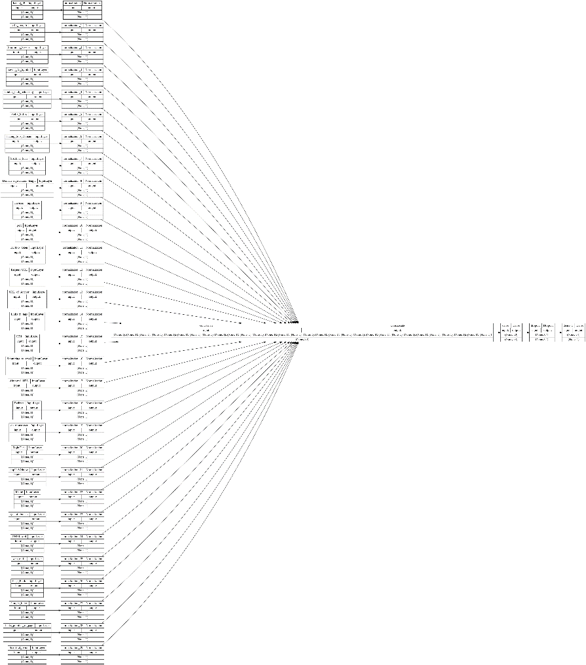
Execution Demo(Video/Screenshots) of the solution:
Model Architecture (zoom in to see clearly)

Slide 9
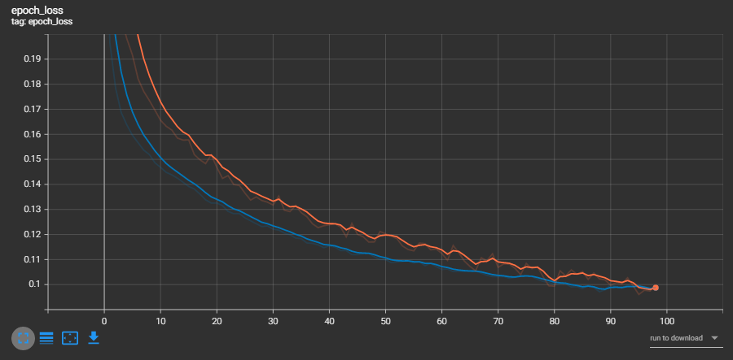
Execution Demo(Video/Screenshots) of the solution:
Loss vs Epochs (orange – train; blue – validation)

Slide 10
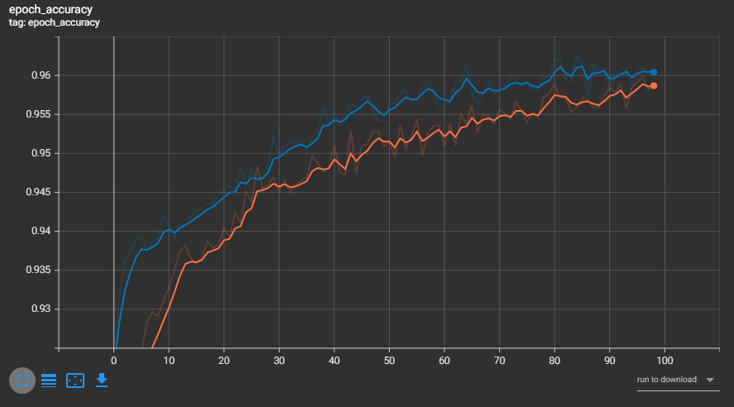
Execution Demo(Video/Screenshots) of the solution:
Accuracy vs Epochs (orange – train; blue – validation)

Slide 11
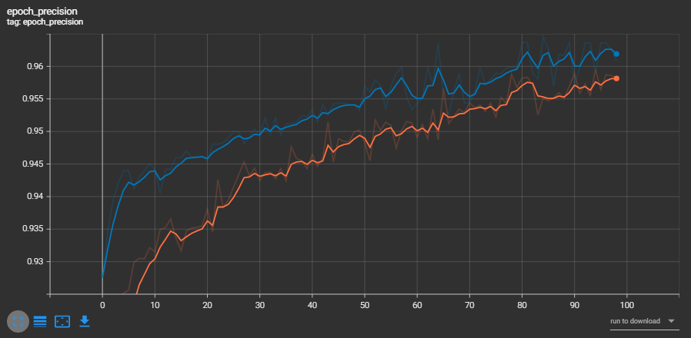
Execution Demo(Video/Screenshots) of the solution:
Precision vs Epochs (orange – train; blue – validation)

Slide 12
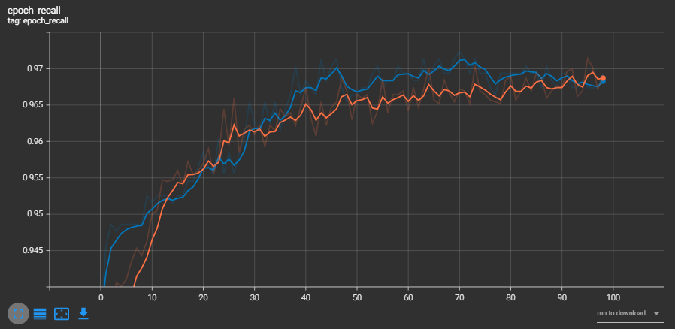
Execution Demo(Video/Screenshots) of the solution:
Recall vs Epochs (orange – train; blue – validation)

Slide 13
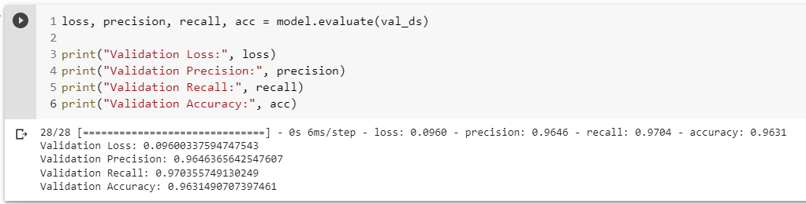
Execution Demo(Video/Screenshots) of the solution:
Dataset | Num of Samples
Train | 7164
Validation | 1791
Dataset | Loss | Precision | Recall | Accuracy
Train | 0.0937 | 0.9610 | 0.9689 | 0.9605
Validation | 0.09600 | 0.9646 | 0.9703 | 0.9631

Slide 14
Source code as ZIP or Github URL:
GITHUB: https://github.com/shreyasvedpathak/Shreyas-Vedpathak-HP-ML-Hackathon
ZIP GOOGLE DRIVE: https://drive.google.com/file/d/1OSF7pKjjQYnJCLzN58PTLGEkuhGAlHD3/view?usp=sharing

Slide 15
Additional comments (optional):

Slide 16
THANK YOU

